Slide 1
Lecture 2
User Requirements
    The voyage of discovery is not in seeking new landscapes but in having new eyes.
(Proust, 1982)
Selections from Heim Chapters 4

Slide 2
Learning Objectives
To describe when user requirements are gathered
To develop a set of skills for systematic analysis of a problem domain to discover HCI issues and requirements
To understand perspectives on data collection including types of stakeholders
To be able to collect data by interviews, focus groups and questionnaires
To be able to create User profiles

Slide 3
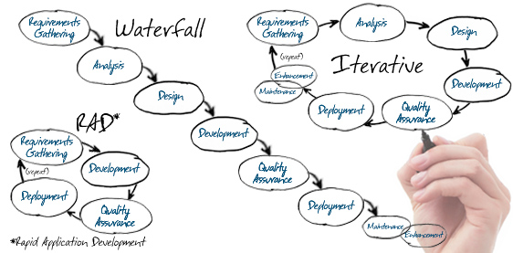
1. When?
At the beginning.
  Of the software development lifecycle - regardless of life cycle
  When writing new software
  Or when evaluating software products

Slide 4
2. Requirements collection processes
During the collection phase you will formally identify:
  The people who are involved with the work
  The things they use to do the work
  The processes that are involved in the work
  The information required to do the work
  The constraints imposed on the work
  The inputs required by the work
  The outputs created by the work
  (more next slide)

Slide 5
2. Requirements collection processes
You will then model the information by:
  Creating descriptions of the people who do the work
  Documenting the main use-cases step-by-step
  Creating different stories about how the various aspects of the work are done
  Creating formal diagrams of the interaction
  Tracing the different stories identified with the various people through the charts and diagrams

Slide 6
2. Requirements HCI vrs Software Dev
HCI Requirements gathering
  User focused
  Concentrates on main ‘use cases’
Software development requirements gathering
  Users, software architecture, data normalization, etc
  Comprehensive
UX (user experience) it a part of software development requirements

Slide 7
3. Discovery Phase Framework
Looking with new eyes
The frame of reference must come from the observation and not be imposed on it
During the discovery phase we must find out what we will need to know about the work that people do
  We must understand what data is needed
  We must use the proper tools to gather and interpret that data

Slide 8
Exploring the Work Domain 1 of 4
Identify all stakeholders
  The people that are involved either directly or indirectly in the work flow
    The people who do the work
    The people who manage the people who do the work
    The people who are affected by the output of the work
    The people who will benefit in some way from the work

Slide 9
Exploring the Work Domain 2 of 4
There are four types of stakeholders:
  Primary—The person who uses the design directly
  Secondary—The person who either supplies input or receives output from the design
  Facilitator—The person who maintains or develops the design
  Indirect—The person who is affected by the use of the design but has no contact with it, such as the user’s superior or coworkers and the client who is paying for the project (the client may or may not also be the primary stakeholder)

Slide 10
Exploring the Work Domain 3of 4
The primary stakeholders should have the most impact on the eventual design.
A new system that is not designed to be integrated with the work that other people in the company do may cause needless disruptions
All stakeholders should be considered during the design

Slide 11
Exploring the Work Domain 4 of 4
Understand the competition
  Learn from other design solutions
  Assess both the positive and negative aspects
  Respect copyrighted material and intellectual property
    You may need the help of your company’s legal team to sort out the right balance of ‘learning from others’ versus original design if you feel the competitor has got it right!
Often times the goal is not to build a new system but to buy a system that best fits

Slide 12
Organizing the Discovery Process 1 of 3
Filters
  Physical—We can describe the physical aspects of the activity.
    Where is it done?
    What objects are involved?
  Cultural—We can look at the activity in terms of the relationships among the people involved.
    Are some people in a position to orchestrate and evaluate the performance of other people?
  Functional—We can also look at these activities in terms of what actually happens.
    Do some people create things?
    Do other people document procedures and communications?

Slide 13
Organizing the Discovery Process 2 of 3
Filters
  Informational—We can look at these activities in terms of the information that is involved.
    What information is necessary to perform a task?
    How does the information flow from one person to another?
    How is the information generated?
    How is the information consumed?

Slide 14
Organizing the Discovery Process 3 of 3
The data must be collected AND organized to transform it into information
The tools we will explore include the following:
  Primary stakeholder profiles (today)
  (next lecture)
  Task analysis
  Storyboarding
  Use cases
Interpretation means going from data to design requirements

Slide 15
4. Collection - Methods of Collection
Methods of Collection
  Observation: Valuable information can be obtained by watching people perform their activities in the context of the work environment.
  Observations can be made directly during the work day or indirectly using video and auditory recordings.
  Elicitation: Elicitation methods also involve direct and indirect methods of investigation, such as interviews, focus groups, and questionnaires.

Slide 16
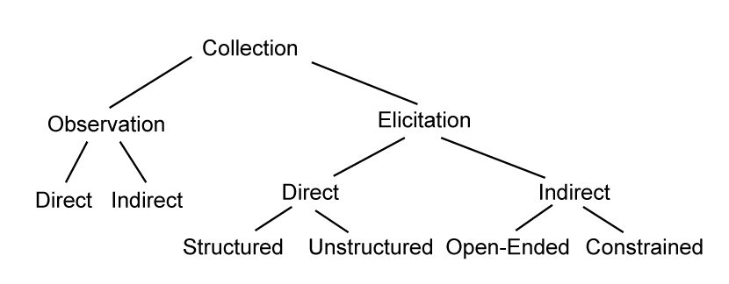
Collection - Methods of Collection

Slide 17

Collection –
Observation 1 of 3
Direct—Ethnographic
methods involve going to
the work site and
observing the people and
the infrastructure that supports the work flow
Indirect—You can use indirect methods of observation by setting up recording devices in the work place
  The use of indirect methods may require a significant degree of transparency

Slide 18
Collection - Observation 2 of 3
Concerns about Ethnographic Observations
  Your presence will affect the people you observe (positive and negative)
    ‘Hawthorne effect’ – employees act differently when ‘management’ is observing their work
  Your presence can become annoying
  It can raise questions with the ‘consumer’
    E.g. in health care – who’s that person in the corner?

Slide 19
Collection – Observation 3 of 3
Distributed Cognition - the tendency to off-load cognitive tasks to objects in the environment (e.g. post-its, calendar, whiteboard) or to distribute them among team members or coworkers

Slide 20
Collection – Elicitation 1 of 15
Tools for eliciting information from the various stakeholders:
  Direct
    Interviews
    Focus groups
  Indirect
    Corporate documentation
    Logs and notes
    Questionnaires

Slide 21
Collection - Elicitation – Direct – Interviews 2 of 15
Be polite and courteous during interviews (people will judge the eventual software product by how you treat them at this stage! And people can be quite threatened that automation will take their job!)
Interviews
  On-site interviews: may help people remember aspects of the job
  Away from job site interviews: not interrupted by normal work related events

Slide 22
Collection - Elicitation – Direct – Interviews 3 of 15
Interviews
  Open-ended questions: can be used to explore issues and elicit rich information about complex topics
  Closed-ended questions: can generally be answered with a polar yes/no response or a simple description.

Slide 23
Collection - Elicitation – Direct – Interviews 4 of 15
Interviews
  Unstructured Interviews/Open-Ended Questions: Early in the design process interviews are generally loosely structured.
  Structured Interviews/Closed-Ended Questions: As the design process proceeds, interviews can become more structured and focused on specific details and areas of the design.

Slide 24
Collection - Elicitation – Direct – Interviews 5 of 15
Interviews
  Predefined Scenarios: The interviewer can use predefined scenarios to stimulate conversation and gain insight
  Focus of Interview: It is important that the purpose of the interview is clearly defined
  Wrap-Up: It is important to share your thoughts about the results of the interview, what will happen next and the timeframe
  Try to keep the interview under an hour
  Avoid leading questions that bias the result

Slide 25
Collection - Elicitation – Direct – Focus Groups 6 of 15
Focus Groups
  Require a moderator/facilitator to keep discussion on track
  Maintain spontaneity
  Have clearly defined outcomes
  Provide participants with a context for the project
  Work best if the participants have a ‘peer’ relationship
    If line workers won’t speak freely in front of line supervisors, then put them in two separate focus groups

Slide 26
Collection - Elicitation – Direct – Focus Groups 7 of 15
The advantages of focus groups:
  They are relatively inexpensive and easy to set up.
  They can be used early in the design process to help to identify and prioritize features.
  They help you to gain insight into people’s attitudes and motivations.
  They make it clear an opinion is an ‘outlier’
  Can help sell a new solution
The disadvantages of focus groups:
  They only represent the views of one particular group.
  A strong voice can capture the group
  They are not statistically significant.
  They do not provide information about usability.

Slide 27
Collection - Elicitation – Indirect 8 of 15
Corporate Documentation—Information can be collected indirectly through corporate documents that reference policies and procedures.
Logs and Notes—Indirect methods can also include user participation;
  Ask people to keep a log of specific activities
  Collect (or photograph) the notes people make to remind them of procedures and policies
    sticky notes tacked onto a computer
    reminders stuck on a corkboard
  Examining electronic logs
Questionnaires

Slide 28
Collection - Elicitation – Indirect – Questionnaires 9 of 15
Questionnaires are familiar
Questionnaires can contain open and closed questions
Questionnaires can include the following:
  Mutually exclusive choices (radio buttons)
  Non–mutually exclusive choices (checkboxes)
  Ranges (overlapping, open-ended)
  Scales (Likert scales, semantic differential scales)
  Short-answer fill-ins
  Comments

Slide 29
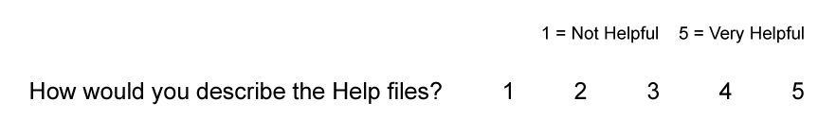
Collection - Elicitation – Indirect – Questionnaires 10 of 15
Likert scale questions.
The following are guidelines for defining scales:
  Identify the scale and the significance of the units
  Use the most intuitive order
  You can use positive or negative scales or a combination of the two
  Use odd numbers when you want to allow neutral responses.
  Use even numbers when you want to force a choice of positive or negative.
  Provide a not applicable (NA) response when appropriate.
  Do not use too many degrees within the scale; seven is considered a general limit.

Slide 30
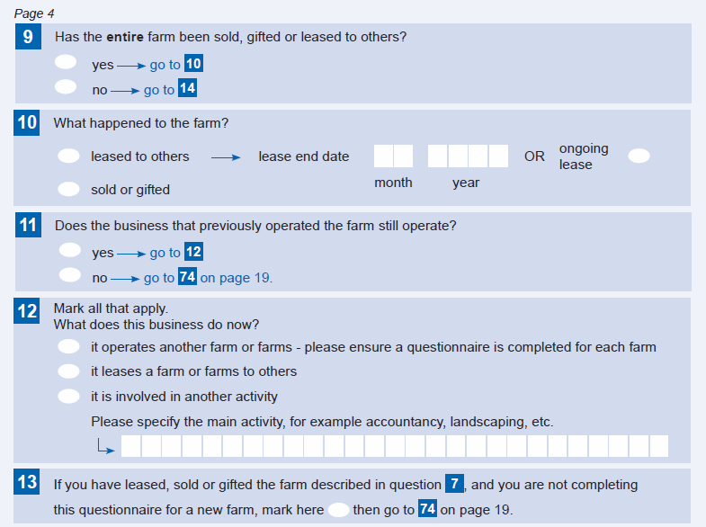
Survey form from www.stats.govt.nz 11 of 15
Really good questionnaires
IRD forms/questionnaires also excellent

Slide 31
Collection - Elicitation – Indirect – Questionnaires 12 of 15
Advantages of questionnaires:
  They do not involve face-to-face contact and can be administered remotely.
  They can be used to supply information for primary stakeholder profiles.
  They can be used to ascertain whether proposed solutions will meet with acceptance as well as to elicit new ideas.
  They can also be used to double-check the feedback obtained from one-on-one interviews.
  They can reach a large audience with relatively little expense.

Slide 32
Collection - Elicitation – Indirect – Questionnaires 13 of 15
Disadvantages of questionnaires:
  Vague questions will return ambiguous responses that will serve no useful purpose or the design.
  People do not like to fill out long questionnaires.
  Closed-ended questions can restrict responses.
  Open-ended questions can be hard to quantify.

Slide 33
Collection - Elicitation – Indirect – Questionnaires 14 of 15
Guidelines for questionnaires:
  Be consistent.
  Phrase instructions clearly.
  Speak the user’s language.
  Avoid jargon or technical terms.
  Order the questions beginning with the easy or less controversial ones.
  Use logical grouping.
  Avoid compound questions.
  Use appropriate form elements, for example, radio buttons, checkboxes, and so on.
  Use an appropriate scales for questions with discrete responses.
  Avoid overlapping ranges.
  Include a “None of the above” when appropriate.
  Be sensitive to the balance of positive and negative questions

Slide 34
Collection - Elicitation - Survey tools 15 of 15
SurveyMonkey
  Popular solution to let you design and distribute questionnaires
  Runs ‘in the cloud’
LimeSurvey
  A free online tool that can be installed directly onto the researcher’s system, thus avoiding storage of data in the cloud (better control of confidential data)

Slide 35
5. Modelling and Documenting Requirements.
Various models are used to document user requirements and systems.
Stakeholder profiles (today)
More next lecture.

Slide 36
Primary Stakeholder Profiles 1 of 5
Primary Stakeholder Profiles are used to define the target user
The constructs covered include:
  Context of use
  Cognitive ability
  Physical ability
  Individual profile

Slide 37
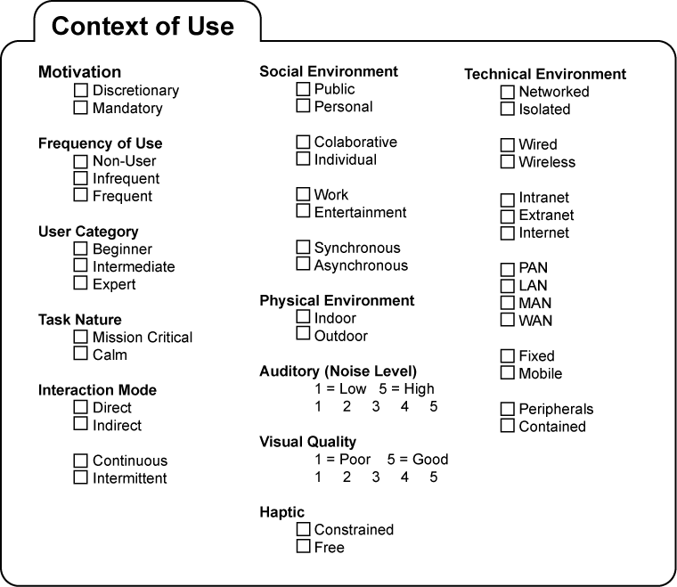
Interpretation - Primary Stakeholder Profiles 2 of 5

Slide 38
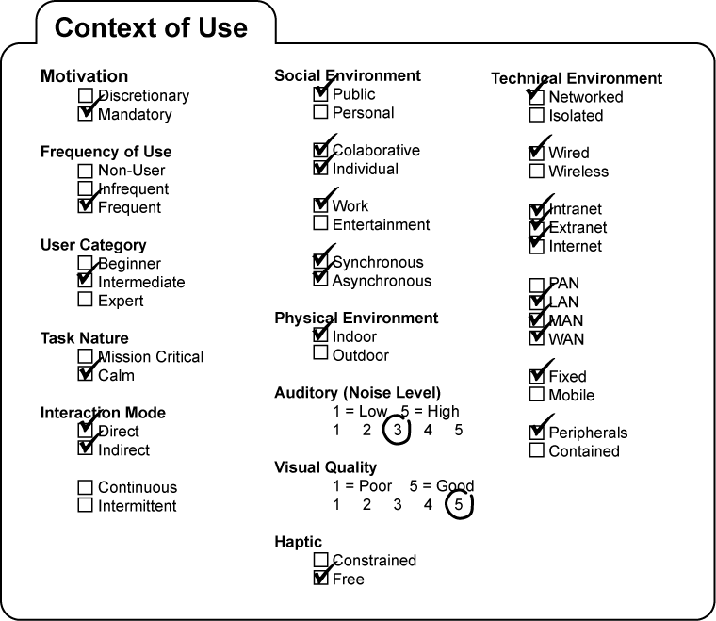
Interpretation - Primary Stakeholder Profiles 3 of 5
Context of Use for a common office desktop system

Slide 39
Primary stakeholder profile – cognitive and physical ability 4 of 5
Cognitive
  Education level
  Computer literacy
  Typing ability
  Cognitive style (e.g. Visual, Linguistic)
Physical ability
  Visual acuity, colour vision, auditory capability
  Motor ability
There are questions about the validity of learning styles

Slide 40
Primary stakeholder profile – individual profile 5 of 5
Age
Gender
Occupation
Interests
Country, language
Ethnicity, religion, socio-economics
These profile elements move us toward personas (and, with the context, toward scenarios) for Interaction Design (lecture 8)

Slide 41
Summary
To describe when user requirements are gathered
Requirements gathering processes
Stakeholders
Data collection:
  observations
  from people (interviews, focus groups and questionnaires)
To be able to create User profiles
  Document the types of users expected
    The voyage of discovery is not in seeking new landscapes but in having new eyes.

